Slide 1
Data Representation
The ways to represent the data are:
 Unsigned Representation
Signed Representation
- Signed magnitude representation
- Signed 1’s complement representation
- Signed 2’s complement Representation

Slide 2
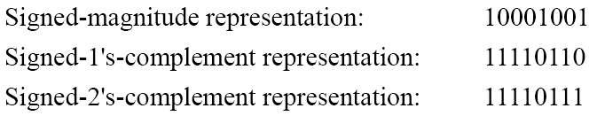
1.6
Signed Binary Numbers
 To represent negative integers, we need a notation for negative
values.
 It is customary to represent the sign with a bit placed in the leftmost position of the number since binary digits.
 The convention
negative.
 Example:
is
to
make
the
sign
bit
0
for
positive
and
1
for

Slide 3
Weighted and Non weighted Code
Weighted Code:-
In weighted code, each digit position has a weight or value. The sum of all digits multiplied by a weight gives the total amount being represented.
We can express any decimal number in tens, hundreds, thousands and so on.
Eg:- Decimal number 4327 can be written as
4327= 4000+300+20+7
In the power of 10, it becomes
4327= 4(10³)+3(10²)+2(10¹)+7(100)
BCD or 8421 is a type of weighted code where each digit position is being assigned a specific weight.
Non-weighted code:-
In non-weighted code, there is no positional weight i.e. each position within the binary number is not assigned a prefixed value. No specific weights are assigned to bit position in non –weighted code.
The non-weighted codes are:-
a) The Gray code b) The Excess-3 code

Slide 4
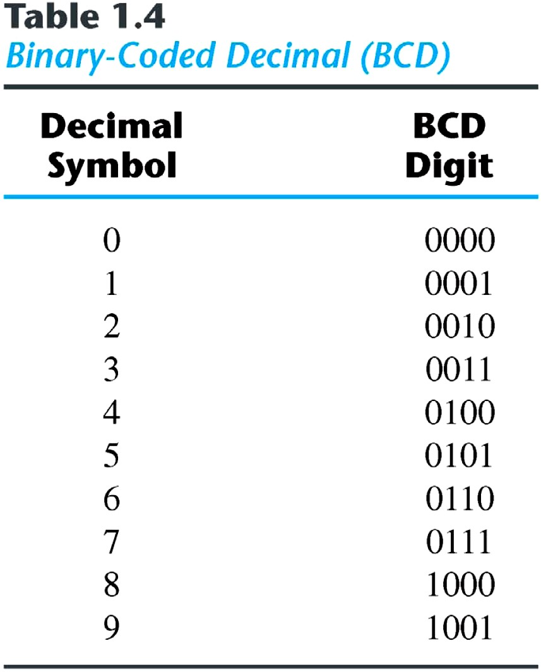
Binary
Codes
BCD or 8421 code:-
It is composed of four bits representing the decimal digits 0 through 9.
The 8421 indicates the binary weights of the four bits(2³,2²,2¹,20).
A number with k decimal digits will
require 4k bits in BCD.
Decimal 396 is represented in BCD with 12bits as 0011 1001 0110, with each group of 4 bits representing one decimal digit.
A decimal number in BCD is the same as its equivalent binary number only when the number is between 0 and 9.
The binary combinations 1010 through 1111 are not used and have no meaning in BCD.

Slide 5
BCD or 8421 Code
Convert following to BCD form
a)47310 b) 31210 c) 25710 d) 11210
Convert following BCD to their decimal equivalent
a)10000110 b) 00110010.10010100
Convert the following binary number numbers to their BCD equivalent.
a)1101.012 b) 11.0112
(Binary to decimal Decimal to BCD)

Slide 6
Comparison of BCD with Binary
1. BCD is less efficient than binary
eg:- (78)10 = (0111 1000)BCD
=(1001110)2
To encode the same decimal number , BCD needs more no. of bits than binary . Hence BCD is less efficient as compared to Binary
2. BCD arithmetic is more complicated than binary arithmetic.
3. Advantage of a BCD code is that the conversion from decimal to BCD or vice versa is simple.

